Slide 1

HFSP Kickoff Meeting
Geut Galai

Slide 2
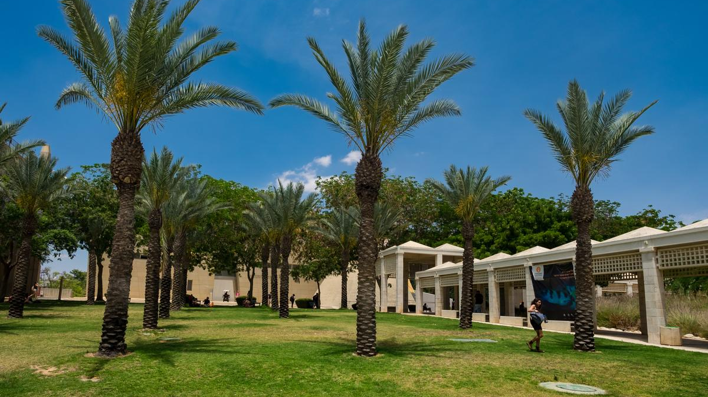
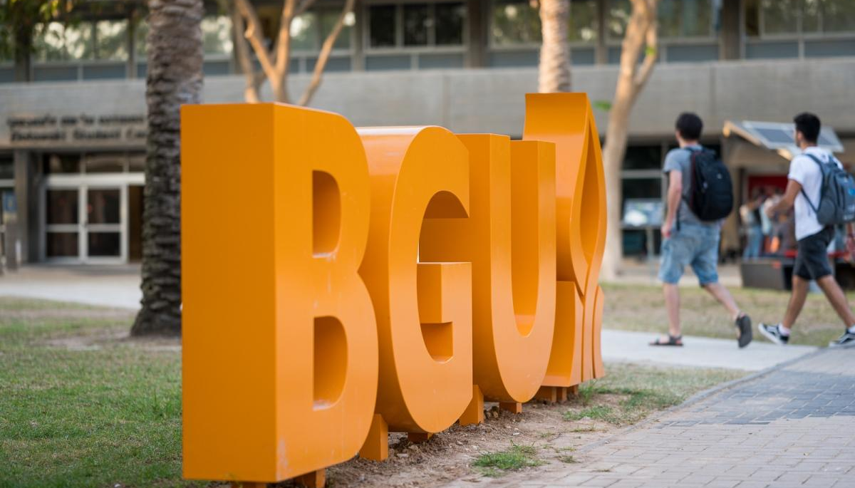
Geut Galai:
Lab manager – Ecological complexity lab
Technical support to projects in the lab.
Take part in research.
Life sciences department in Ben-Gurion University

Slide 3
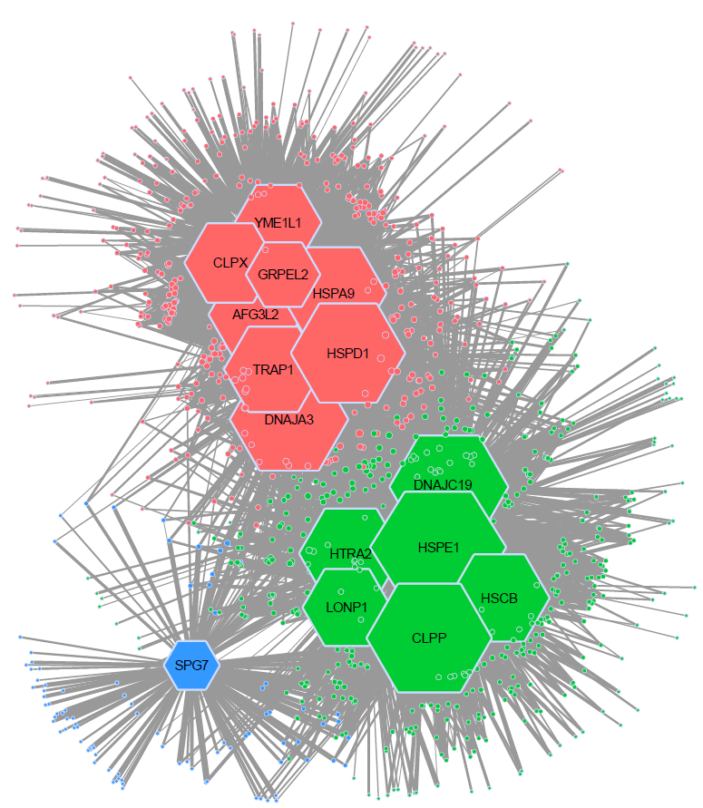
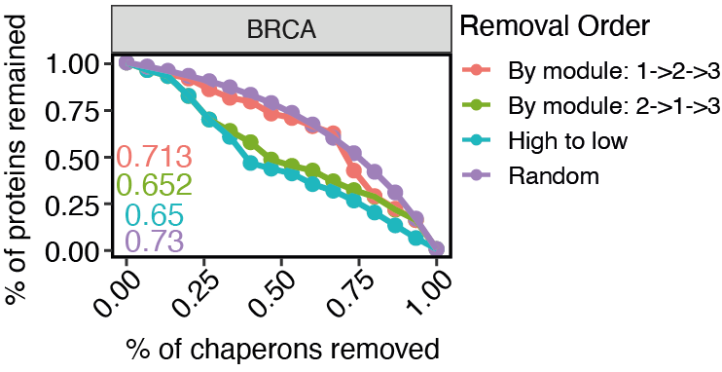
Research
Master’s thesis:
Investigating the structure of chaperon-protein networks in the mitochondria of cancer cells using tools and theory from network ecology –
Community detection (Infomap)
Robustness analysis
Public gene expression data
Build Co-expression networks
One per cancer type
Network Analysis
Notes:
We mainly found evidance for a niche seperation among proteins, with a potencial biological functionality.
We also found an affect of the cancer environment on the correlations of the proteins and their importans to the network.

Slide 4
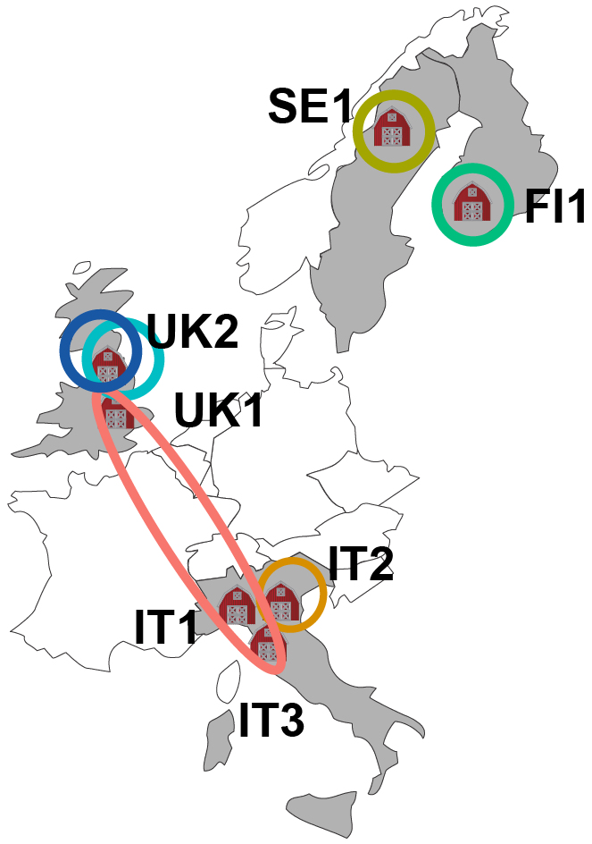
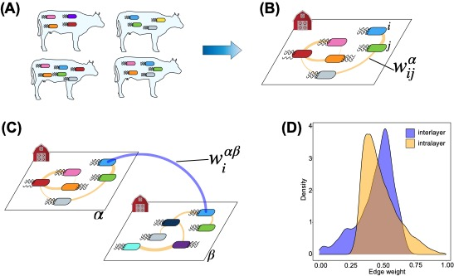
Research
Published rumen microbiome data
Collected from farms across Europe
Currently:
Scale dependence of the microbiome structure in the rumen of cows:
Multilayer network assembly
Community detection
Partner fidelity
Build Co-occurrence networks
One per Farm
Assemble farms to a multilayer network
Using partner fidelity
Network Analysis
Notes:
In one of the projects I helped the most we wanted to find what in what scale operate the processes that affect the structure of microbiome in the rumen of cows.

Slide 5

Expertise
Rich background in Programming:
R, Python, Julia*
MacOS, Windows, Linux
Network Analysis
Data structures
Multilayer
Basic dynamic modeling* (ODES, Gillespie)

Slide 6
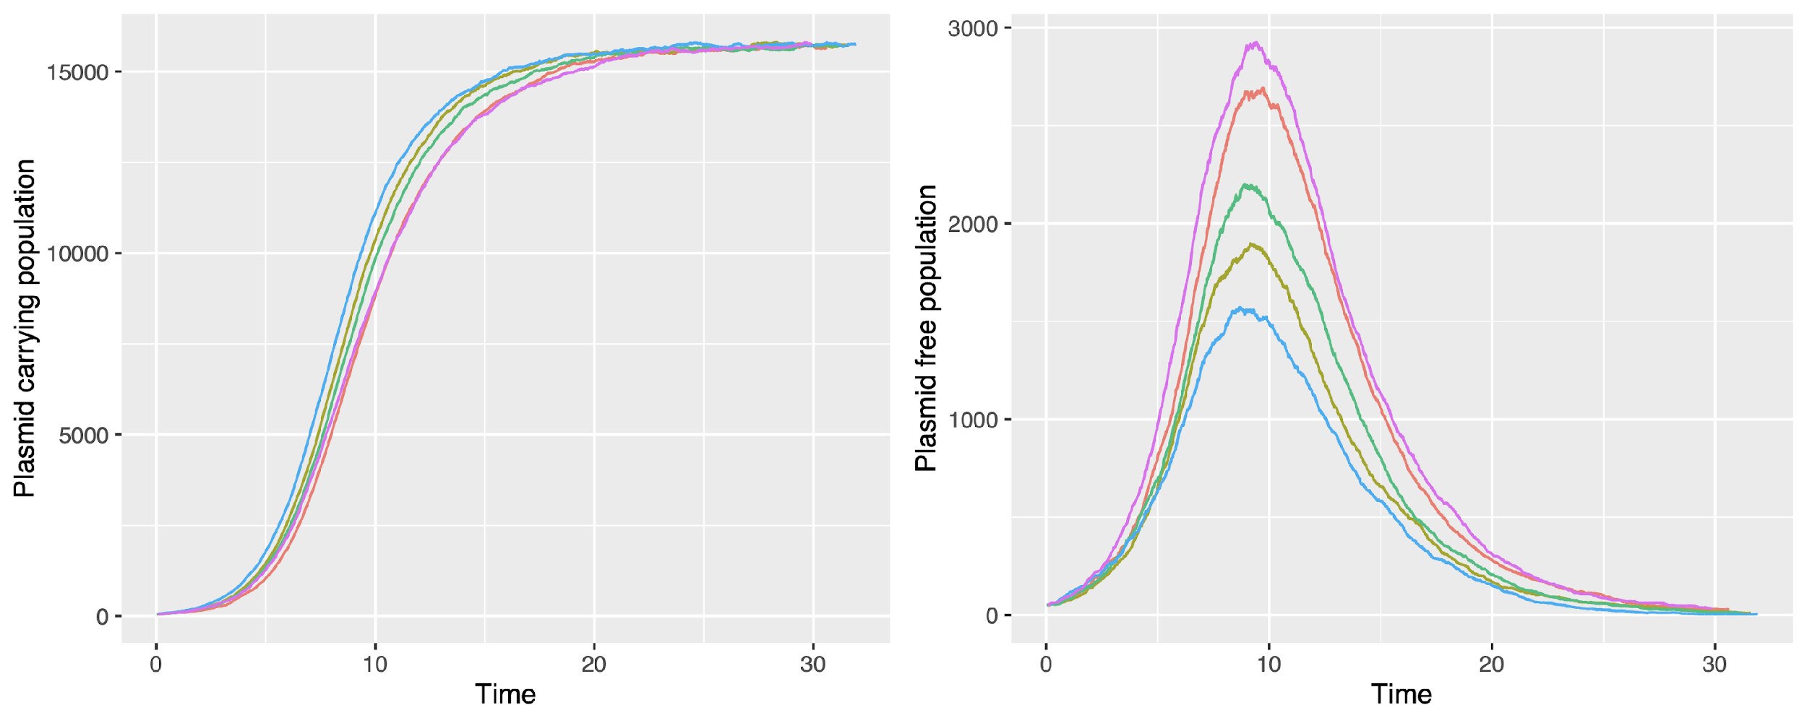
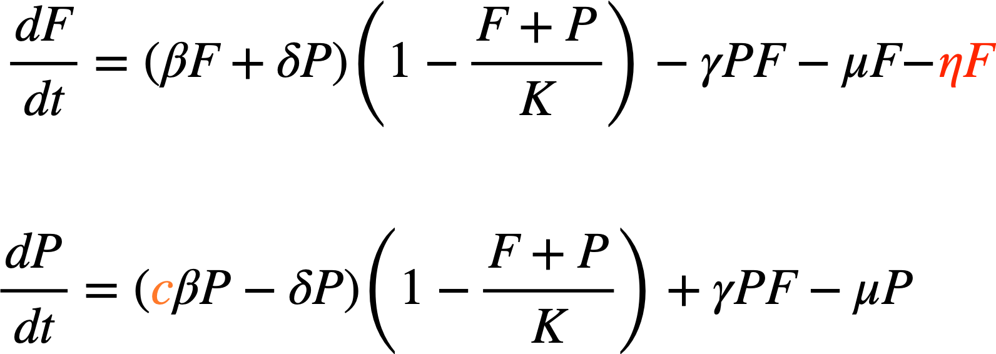
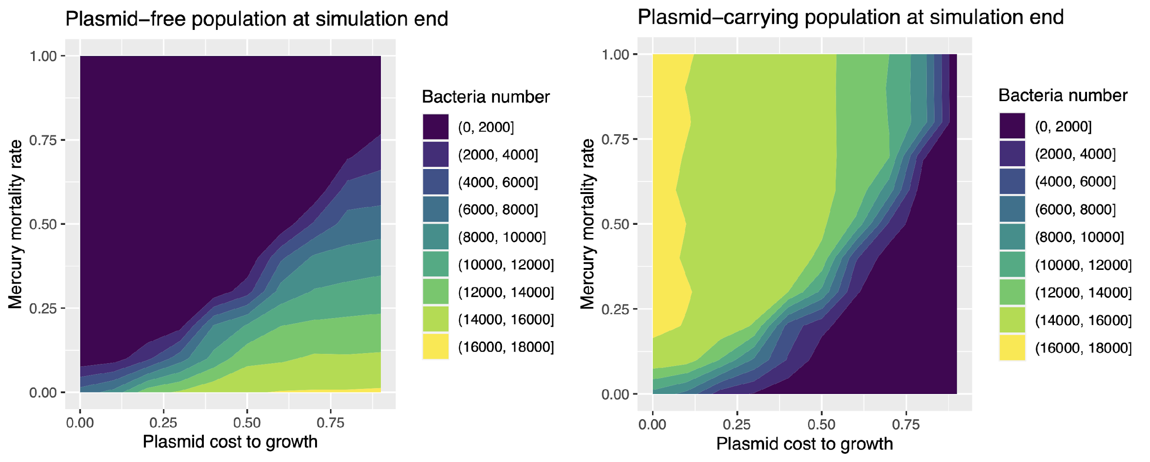
Expertise
Gillespie:
SIR and LV-like models
Plasmid transmission model (including phase figures):

Slide 7

Contribution to the Project
Give computational (technical) support.
Give conceptual support.
Learn ABM methods to be used in the research.
Notes:
Learn and then help implement Agent based modeling in the project

